Slide 1
Chapter 7
Transport-Level
Security

Slide 2
Outline
Web Security Considerations
Secure Socket Layer (SSL) and Transport Layer Security (TLS)
Secure Electronic Transaction (SET)
Recommended Reading and WEB Sites

Slide 3
7.1Web Security Considerations
Internet is two ways.
The WEB is servering as a highly visible outlet for corp and product.
Complex software hide many security flaws.
Web servers can be exploited as a launching pad to the entire network.
Users are not aware of the risks.

Slide 4
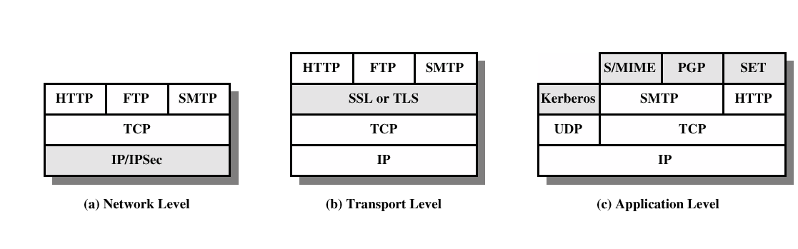
Security facilities in the TCP/IP protocol stack

Slide 5
Web approach
Communication on the web means web browsers talking to web servers using HTTP
The web approach involves
  Leaving HTTP as it is
  Adding security just above the transport layer
This is variously known as
  Secure Socket Layer (SSL)
    Originated by Netscape
  Transport Layer Security (TLS)
    Vendor-neutral standard
SSL and TLS are practically the same

Slide 6
Uses of SSL
Encrypting sensitive data sent between browser and web server
  Credit card numbers
  Reading web email
  Online banking
Authenticating participants
  To verify that web server is genuine (not spoof)
  To verify that user/browser is genuine (optional)

Slide 7
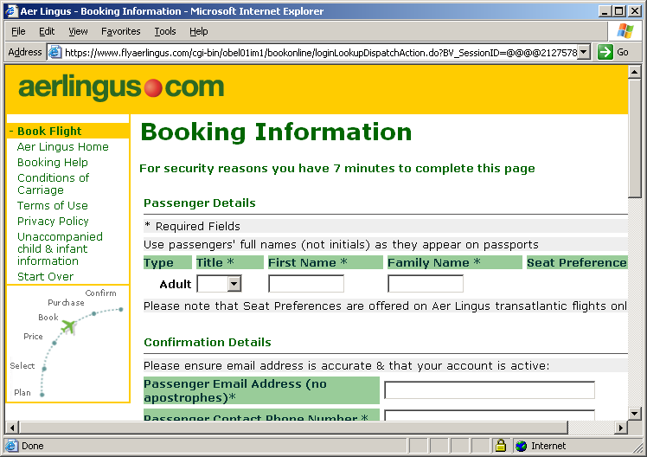
Recognising an SSL page
URL begins
with https:
rather than
http:
(Possibly)
pop-up
letting you
know
Closed lock
icon on
browser
Web server using 443 port for ssl connection.

Slide 8
7.2 SSL and TLS
SSL was originated by Netscape
TLS working group was formed within IETF
First version of TLS can be viewed as an SSLv3.1

Slide 9
SSL Protocol Overview
SSL has 2 layers of protocols:
One layer is a set of protocols for setting up a session, changing parameters, etc
  SSL Handshake Protocol
  SSL Change Cipher Spec Protocol
  SSL Alert Protocol
The other is the “workhorse”, doing the encryption and authentication
  SSL Record Protocol

Slide 10
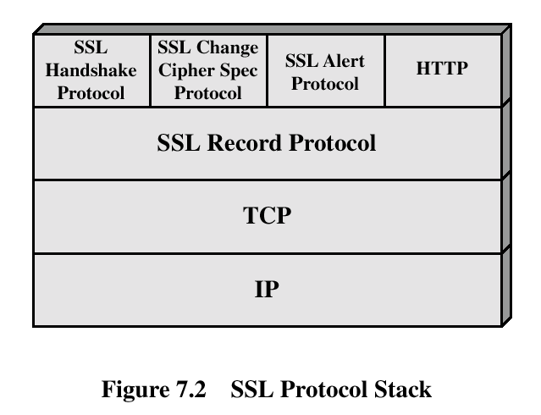
SSL Architecture

Slide 11
Two important concept
SSL session
  Association between client & server
    At [host, port] level
  Created by the SSL Handshake Protocol
  Defines algorithms, key size, etc
  May be shared by multiple SSL connections
SSL connection
  Transient, peer-to-peer, communications link
  Associated with one SSL session

Slide 12
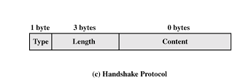
Handshake Protocol
The most complex part of SSL.
Allows the server and client to authenticate each other.
Negotiate encryption, MAC algorithm and cryptographic keys.
Used before any application data are transmitted.
>=0 bytes

Slide 13
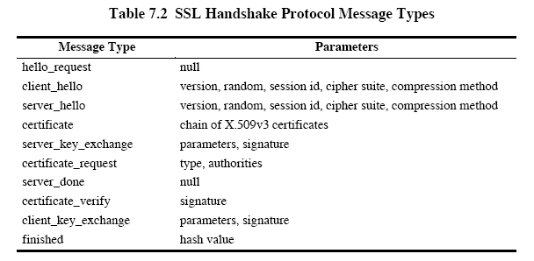

Slide 14
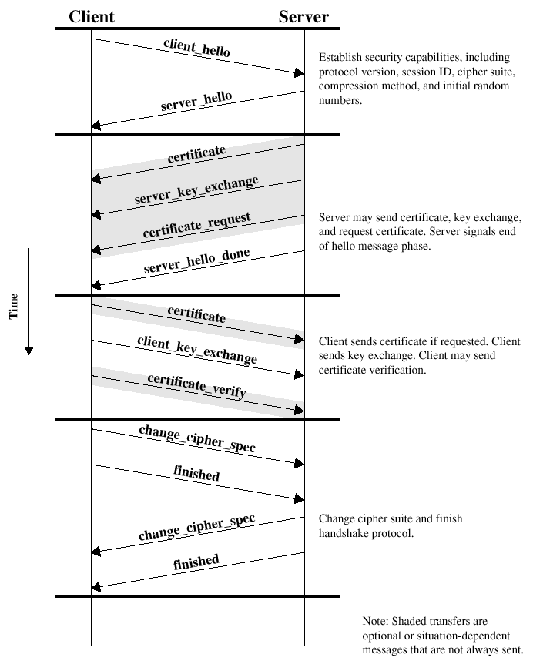
Handshake protocol action

Slide 15
实例化：
A：客户端
B：服务器
A：我想和你安全的通话，我的对称加密算法有DES,RC5,密钥交换算法有RSA和DH，摘要算法有MD5和SHA。
B：我们用DES－RSA－SHA这对组合好了。这是我的证书有我的名字和公钥，拿去验证我的身份（把证书发给A）。
A：（查看证书上B的名字，通过已有的CA的证书验证了B的证书的真实性，如果有误， 发出警告并断连）
（产生一份秘密消息，秘密消息处理后将用作加密密钥、加密初始化向量和hmac的密钥。将这份秘密消息用B的公钥加密、封装。由于用了B的公钥， 保证了第三方无法窃听）
我生成了一份秘密消息，并用你的公钥加密了，给你（发给B）
注意，下面我就要用加密的办法给你发消息了！
（将秘密消息进行处理，生成加密密钥，加密初始化向量和hmac的密钥）
B：（用自己的私钥将收到秘密消息解密出来，进行处理，生成加密密钥、加密初始化向量和hmac的密钥，已安全协商出加密办法）
注意，我也要开始用加密的办法给你发消息了！
A: [我的秘密是...]
B: [其它人不会听到的...]

Slide 16
Cryptographic Computations
Master Secret Creation
S1: a pre_master_secret is exchanged (phase 3)
S2: the master secret is calculated by both parties.
Master_secret=MD5(pre_master_secret||Sha(‘A’||pre_master_secret||ClientHello.random||ServerHello.random))|| MD5(pre_master_secret||Sha(‘BB’||pre_master_secret||ClientHello.random||ServerHello.random))|| MD5(pre_master_secret||Sha(‘CCC’||pre_master_secret||ClientHello.random||ServerHello.random))

Slide 17
Cryptographic Computations
Generation of Cryptographic Parameters
CipherSpecs requires client write MAC secret, server write MAC secret, client write secret, server write secret, client write IV , server write IV.
keyblocks=MD5(master_secret||Sha(‘A’||master_secret||ClientHello.random||ServerHello.random))|| MD5(master_secret||Sha(‘BB’||master_secret||ClientHello.random||ServerHello.random))|| MD5(master_secret||Sha(‘CCC’||master_secret||ClientHello.random||ServerHello.random))………

Slide 18


Change Cipher Spec & Alert Protocols (page 221)
Change Cipher Spec Protocol
  Updates cryptographic attributes (algorithms, keys, etc) for current connection
Alert Protocol
  Signals warning or fatal alerts
  Sample alerts:
    unexpected message
    decompression failure
    unsupported certificate
    certificate revoked
    certificate expired

Slide 19
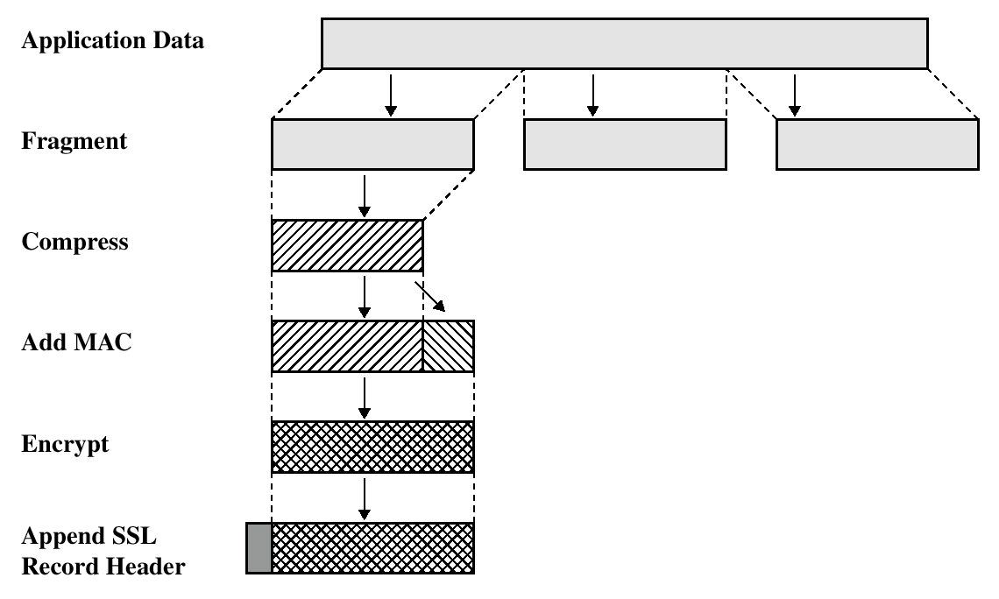
SSL Record Protocol Operation

Slide 20
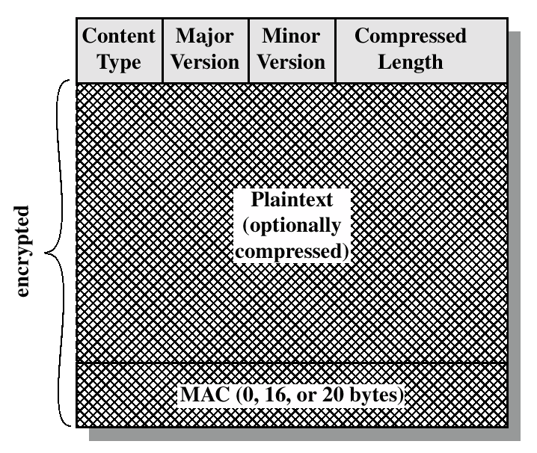
SSL Record Format

Slide 21
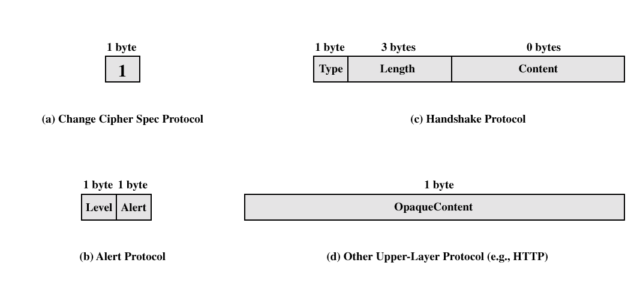
SSL Record Protocol Payload

Slide 22
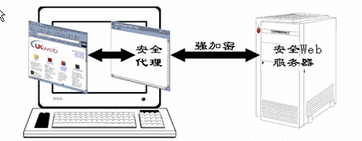
SSL代理
实现：
在浏览器里设置https的代理（如127.0.0.1），在浏览器访问网络时：
浏览器与proxy建立tcp链接，发出：
CONNECT server.example.com:443 HTTP/1.1
Host: server.example.com:443
然后proxy会向webserver端建立tcp连接；
之后这个代理便成了内容转发装置；
浏览器与目标机建立一个安全通道（端到端）
用途：
在无法提高浏览器的加密级别的情况下，
用SSL代理实现高位加密。

Slide 23
Transport Layer Security
The same record format as the SSL record format.
Defined in RFC 2246.
Similar to SSLv3.
Differences in the:
  version number
  message authentication code
  pseudorandom function
  alert codes
  cipher suites
  client certificate types
  certificate_verify and finished message
  cryptographic computations
  padding

Slide 24
Secure Electronic Transactions
An open encryption and security specification.
Protect credit card transaction on the Internet.
Companies involved:
  MasterCard, Visa, IBM, Microsoft, Netscape, RSA, Terisa and Verisign
Not a payment system.
Set of security protocols and formats.

Slide 25
SET Services
Provides a secure communication channel in a transaction.
Provides tust by the use of X.509v3 digital certificates.
Ensures privacy.

Slide 26
SET Overview
Key Features of SET:
  Confidentiality of information
  Integrity of data
  Cardholder account authentication
  Merchant authentication

Slide 27
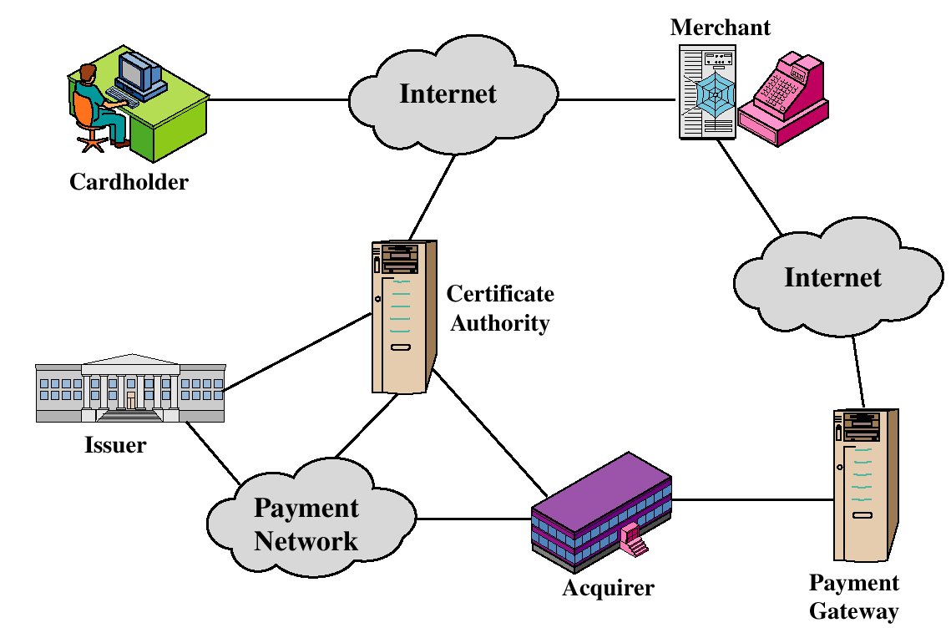
SET Participants

Slide 28
Sequence of events for transactions
The customer opens an account.
The customer receives a certificate.
Merchants have their own certificates.
The customer places an order.
The merchant is verified.
The order and payment are sent.
The merchant request payment authorization.
The merchant confirm the order.
The merchant provides the goods or service.
The merchant requests payments.

Slide 29

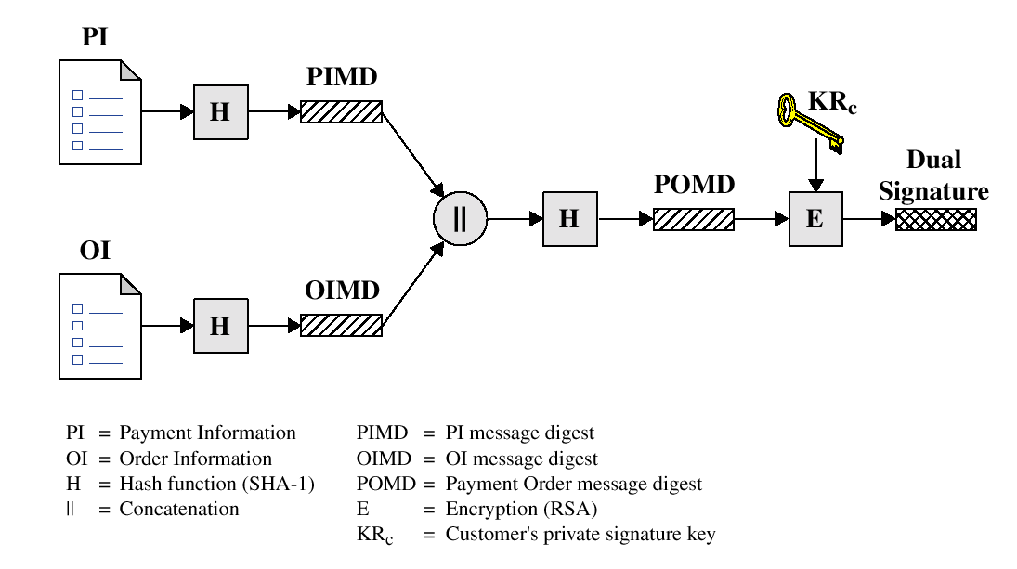
Dual Signature

Slide 30
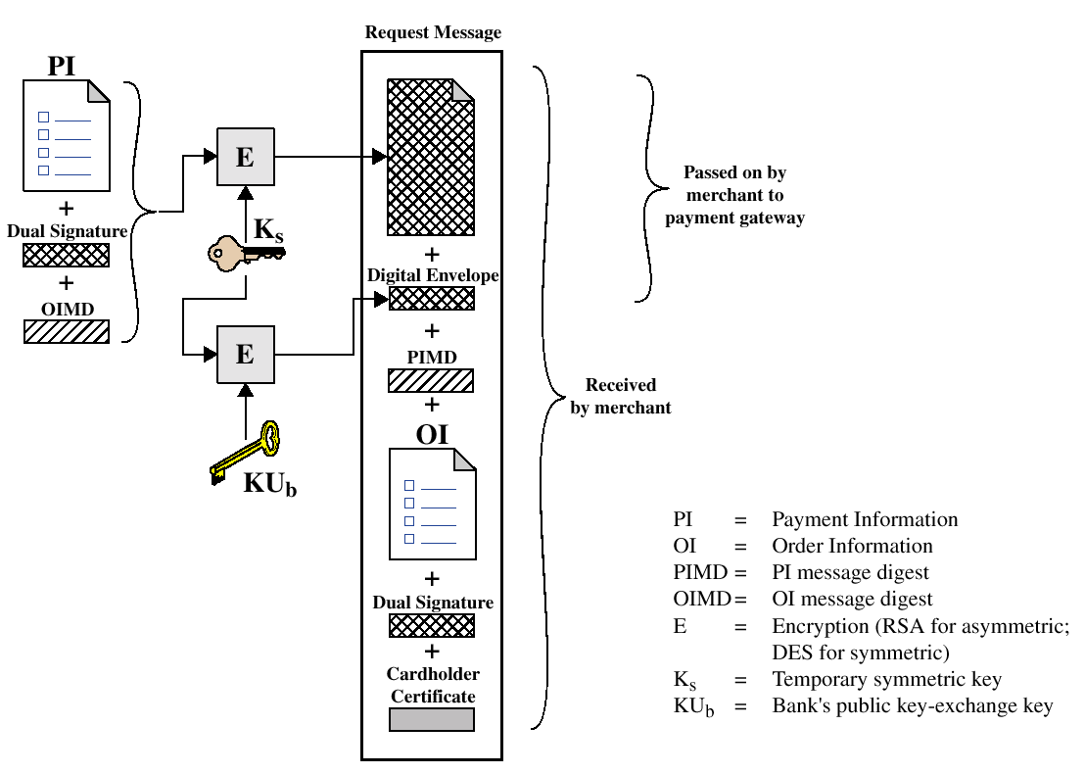
Payment processing
Cardholder sends Purchase Request

Slide 31
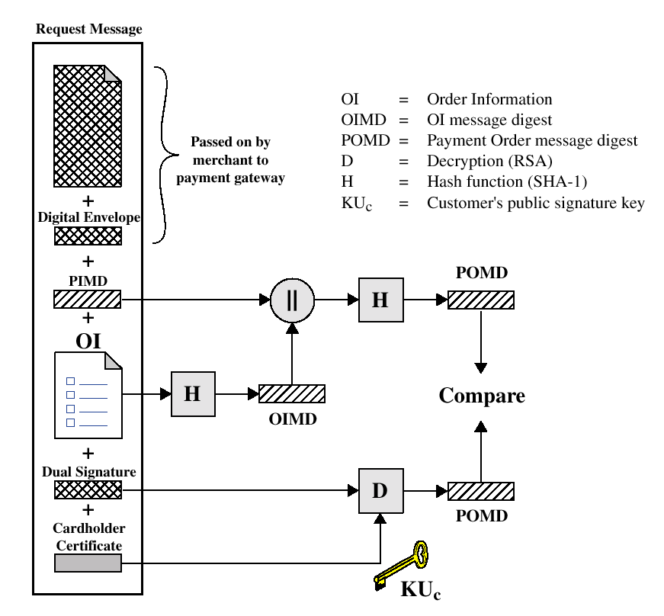
Payment processing
Merchant Verifies Customer Purchase Request

Slide 32
Payment processing
Payment Authorization:
  Authorization Request
  Authorization Response
Payment Capture:
  Capture Request
  Capture Response

Slide 33
Recommended Reading and WEB sites
Drew, G. Using SET for Secure Electronic Commerce. Prentice Hall, 1999
Garfinkel, S., and Spafford, G. Web Security & Commerce. O’Reilly and Associates, 1997
MasterCard SET site
Visa Electronic Commerce Site
SETCo (documents and glossary of terms)

